Slide 1

BASIC DETAILS OF TEAM & PROBLEM STATEMENT
Ministry:
Government of Rajasthan
P.S. Code:
TK1050
Problem Statement Title:
To create systems that alleviate waiting in line - at doctors, at shops, at bus stops.
Team Name:
“Optimizers”
Team Leader Name:
Md Kashif Raza
Institute Name:
Institute of Engineering and Technology, Devi Ahilya Vishwavidyalaya
Institute AISHE Code:
U-0270
Theme/ Domain Bucket:
Miscellaneous

Slide 2
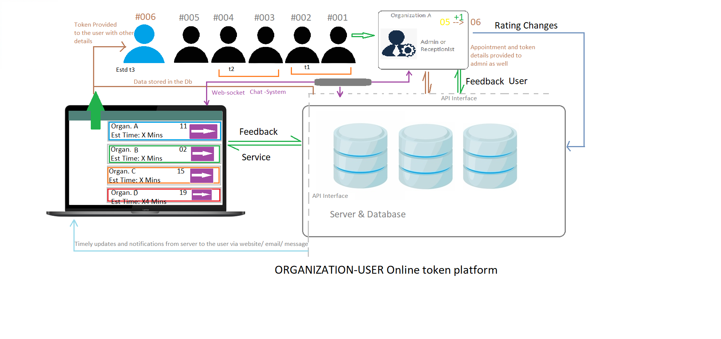
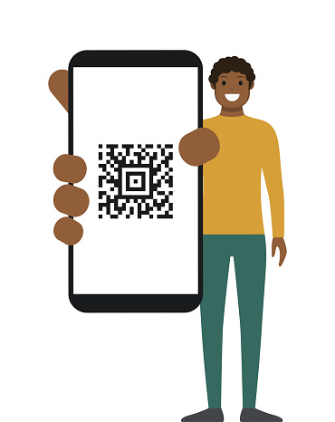
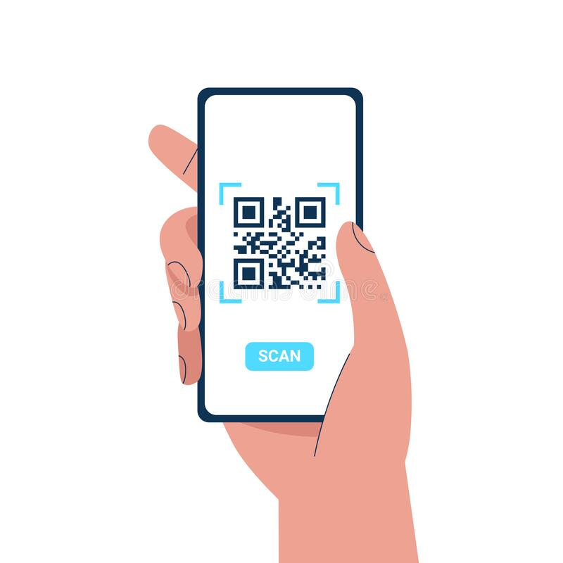

Idea/ Approach Details:
Working-flow chart & prototype image
Solution & protype description:
User are able to view the facility centres using Web-Application according to their location and requirement (e.g. Medical Store/ Clinic / Shops/ Bus Stops etc.)
Easy and simple to use application to scan the QR-Code provided at the organization and 2 steps token providing system
An online token-based service will be provided to them to manage the queue and appointment details with the respective organization with token limits that can be governed either by closing-time or the number of appointments.
They will be provided with regular updates, estimated time of their appointment, options to cancel or reschedule the appointment whose details will be shared with the facility-administrators.
After the completion of session, users will be provided with feedback form via website/ email/message that the service provided was good or not?
Technology Stack:
Backend-API: Node JS, Express, MongoDB, Mocha and Chai Testing Framework, Postman.
Web-backend: Node JS, Socket.io
Web-frontend: HTML, CSS and JavaScript and Bootstrap.
Deployment: Heroku, Github

Slide 3
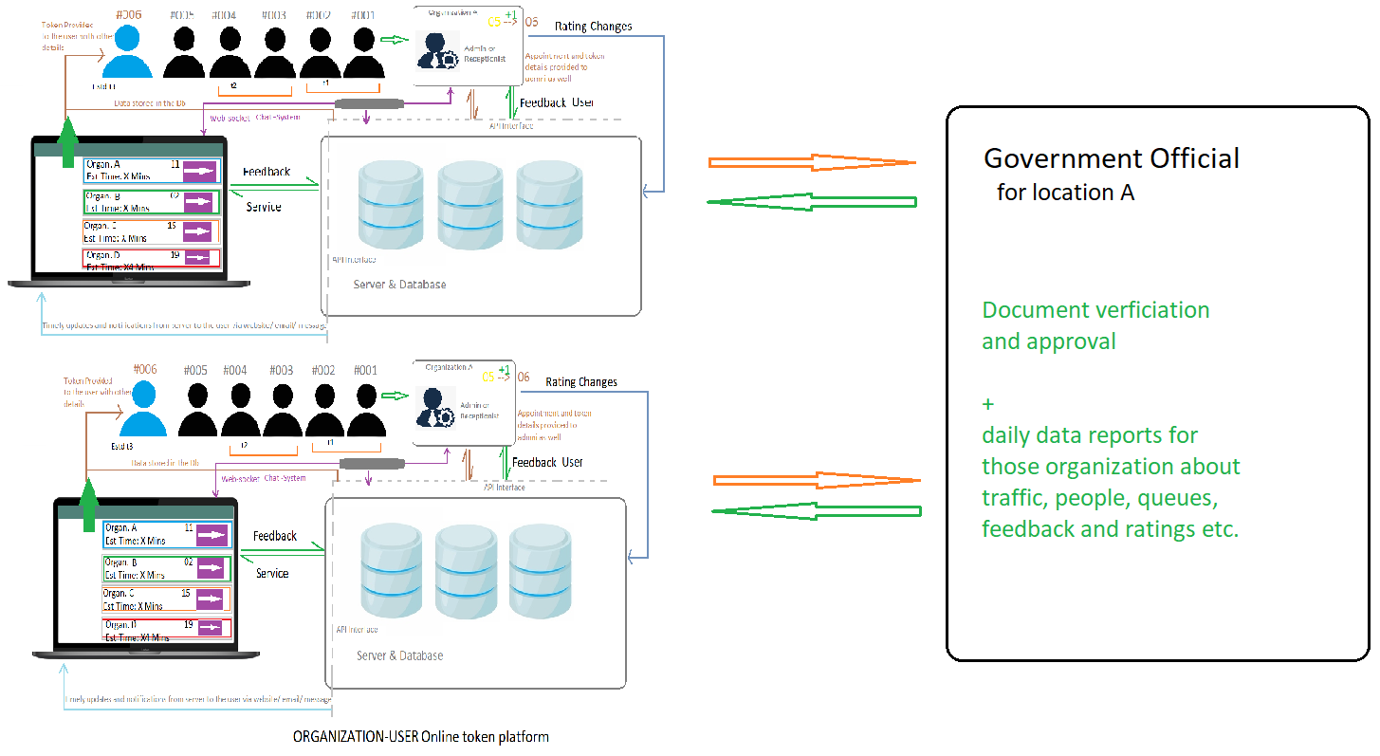
Idea / Approach details
Use Cases of Solution
This system cannot only work for particular organization like hospitals etc, but can also work for any institute where there is need for queues.
Important information like for hospitals (Beds) will also be displayed in the application front-end
The QR Code can be verified by the organization through scanning as well
Novel Points of our Application / Dependencies
1-click token for appointment with any registered organization.
System of QR-Code to be scanned by any QR scanner to get the token registered on a click.
Ratings of organization according to previous given feedbacks of users.
Feature to provide best alternatives of an organization based on the number of appointments, location and ratings.
All organization’s registration will be governed by state officials from gathering their details to verification of the documents to provide safety and protect consumer rights.
This system will be completely generic and not only used by hospitals but is being created to be used by any organization where there is problem of queue.

Slide 4
Team Member Details
Team Leader Name: Md Kashif Raza
Branch: B.E. Stream: Electronics & Telecommunications Year: III (3rd)
Team Member Name: Sakshi Magre
Branch: B.E. Stream: Electronics & Telecommunications Year: III (3rd)
Team Member Name: Muskaan Agrawal
Branch: B.E. Stream: Electronics & Telecommunications Year: III (3rd)
Team Member Name: Milisha Gupta
Branch: B.E. Stream: Electronics & Telecommunications Year: III (3rd)
Team Member Name: Kuldeep Gaur
Branch: B.E. Stream: Electronics & Telecommunications Year: III (3rd)
Team Member Name: Chirag Rawat
Branch: B.E. Stream: Electronics & Telecommunications Year: III (3rd)
Team Mentor Details
Team Mentor 1 Name: Prof. Vaibhav Neema
Category: Academics Expertise: VLSI/ CMOS Domain Experience: 20 Years
Team Mentor 2 Name: Mr. Govind Chaudhary
Category: Industry Expertise: Software Engineering/ Backend Dev. Domain Experience: 03 Years

